Slide 1

Terrain Aware Adaptive Control
Mentors: Sorina Lupu, Soon-Jo Chung
Date: 2023-08-24
Emilia Sjögren

Slide 2
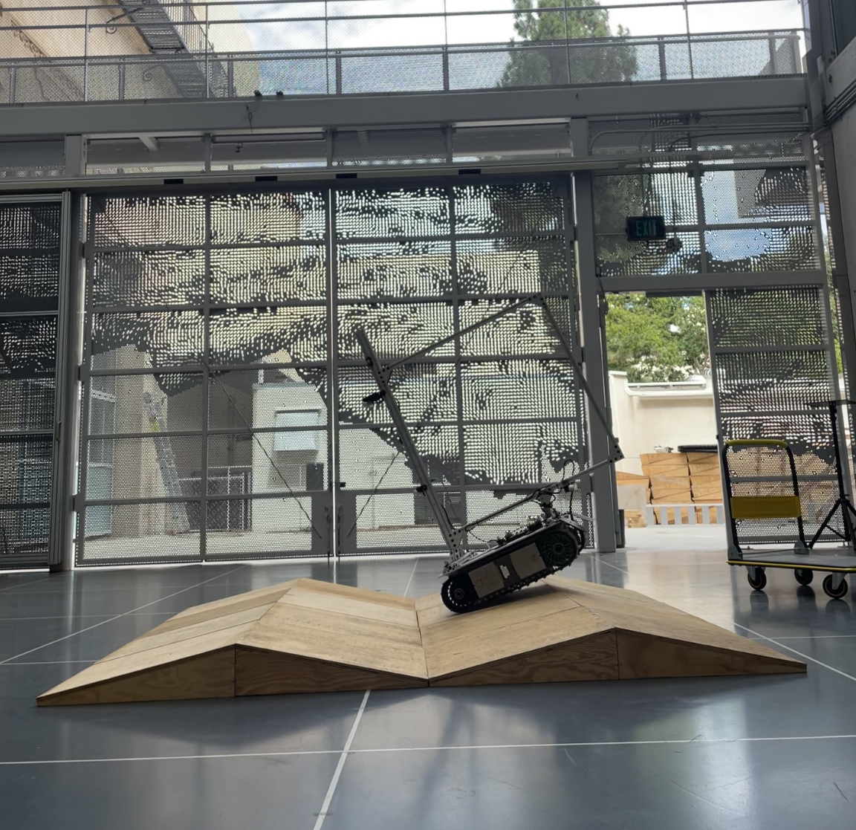
Introduction
Integrating terrain info in adaptive control algorithms
Utilizing vision transformers
Dino and DinoV2 from Meta AI
Feature embedders
| Introduction

Slide 3

Motivation
Autonomous ground vehicles
Utilized in many domains
Operate off-road without getting stuck
Terrain awareness
Mars rovers, Spirit and Opportunity, stuck on sand and experienced slippage of 20%
Source: https://mars.nasa.gov/mer/mission/ rover-status/#recent
| Introduction

Slide 4



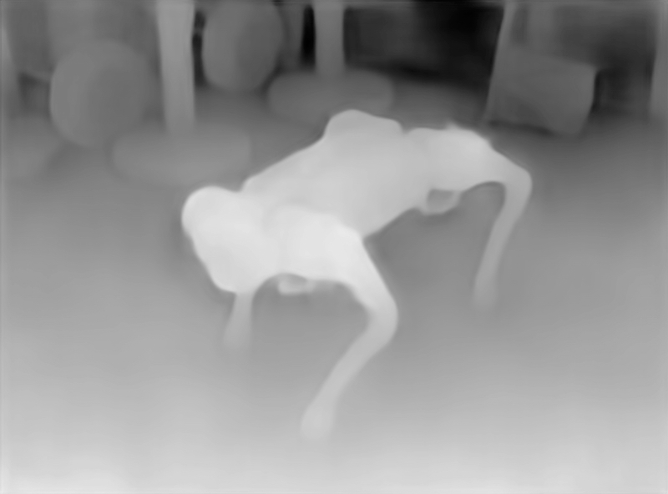
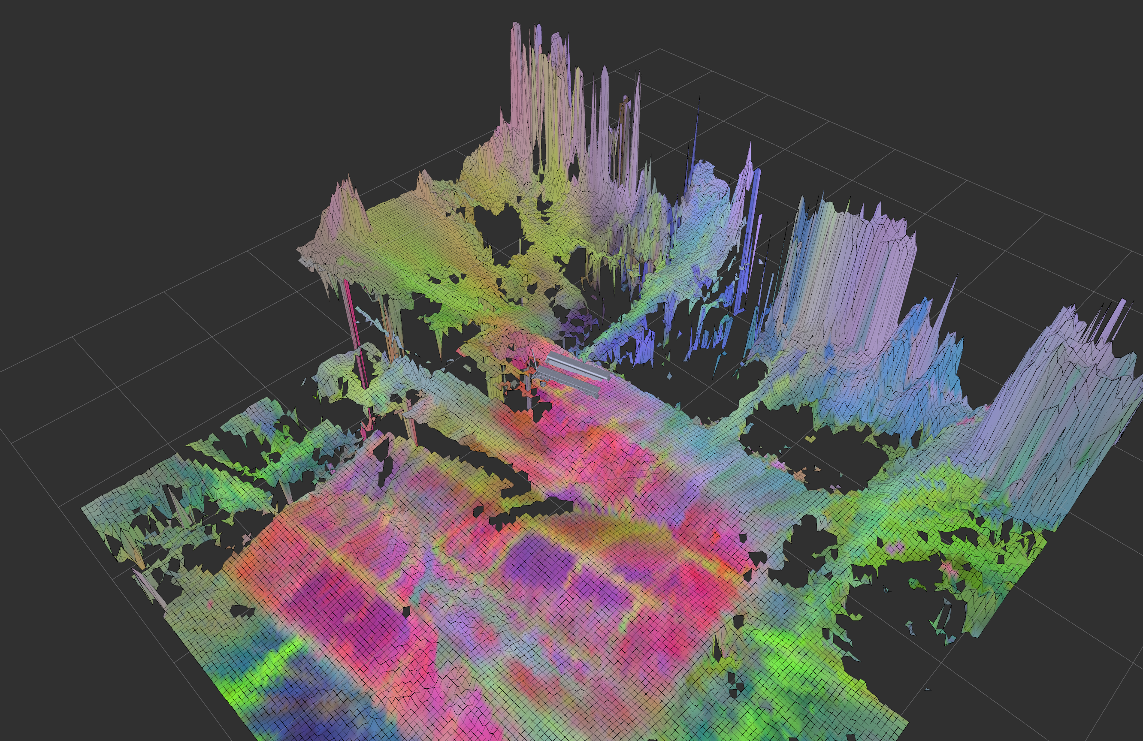
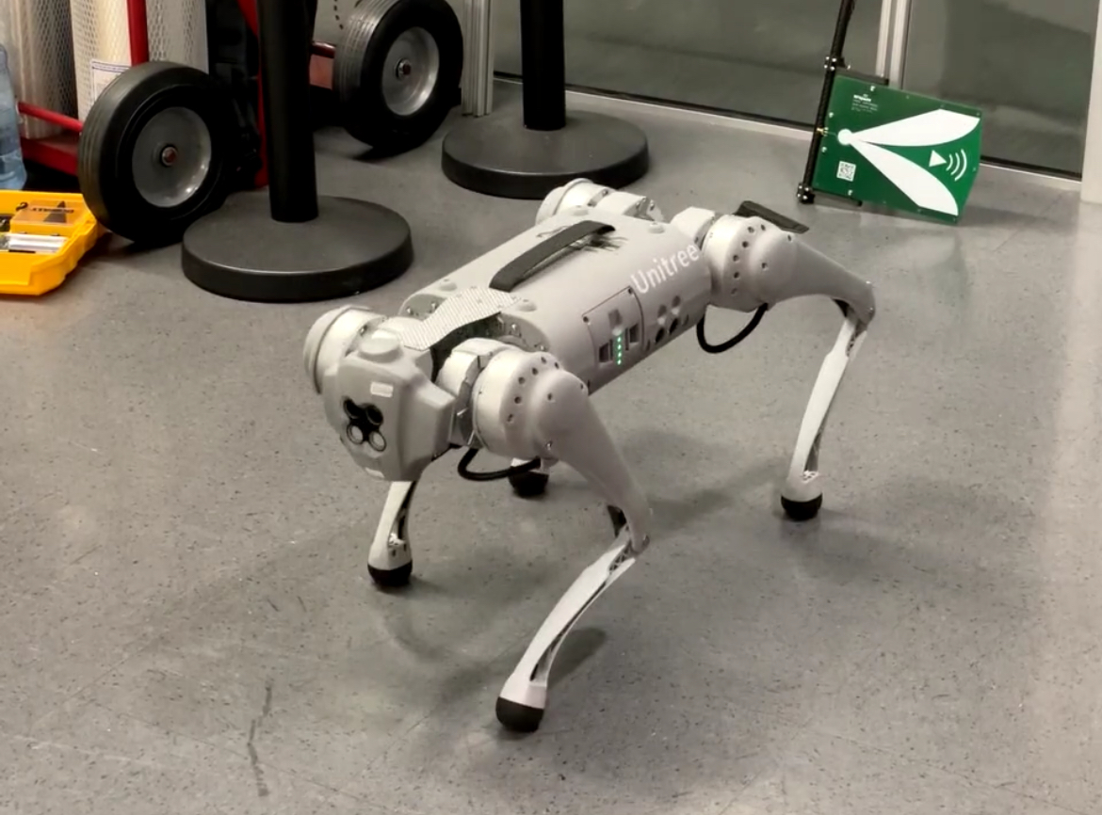

Pipeline of the Project
1
2
3
4
Collect images
Extract RGBD images
Extract DINO features and project them as elevation map or point cloud
Adaptive Control
| Method

Slide 5





Agenda
THEORY
Project’s pipeline
Vision transformers
Dino and DinoV2
Dimensionality reduction
Point clouds
RESULTS
PCA on Dino
PCA different terrains
Elevation Map
DISCUSSION
Dimensionality reduction method
Evaluate PCA on Dino
Elevation map
SUMMARY
Summarize
Future work
| Introduction

Slide 6
Vision Transformers
A machine learning architecture
Inspired by Natural Language Processing
Training on images
Flattens image instead of convoluting
| Theory

Slide 7
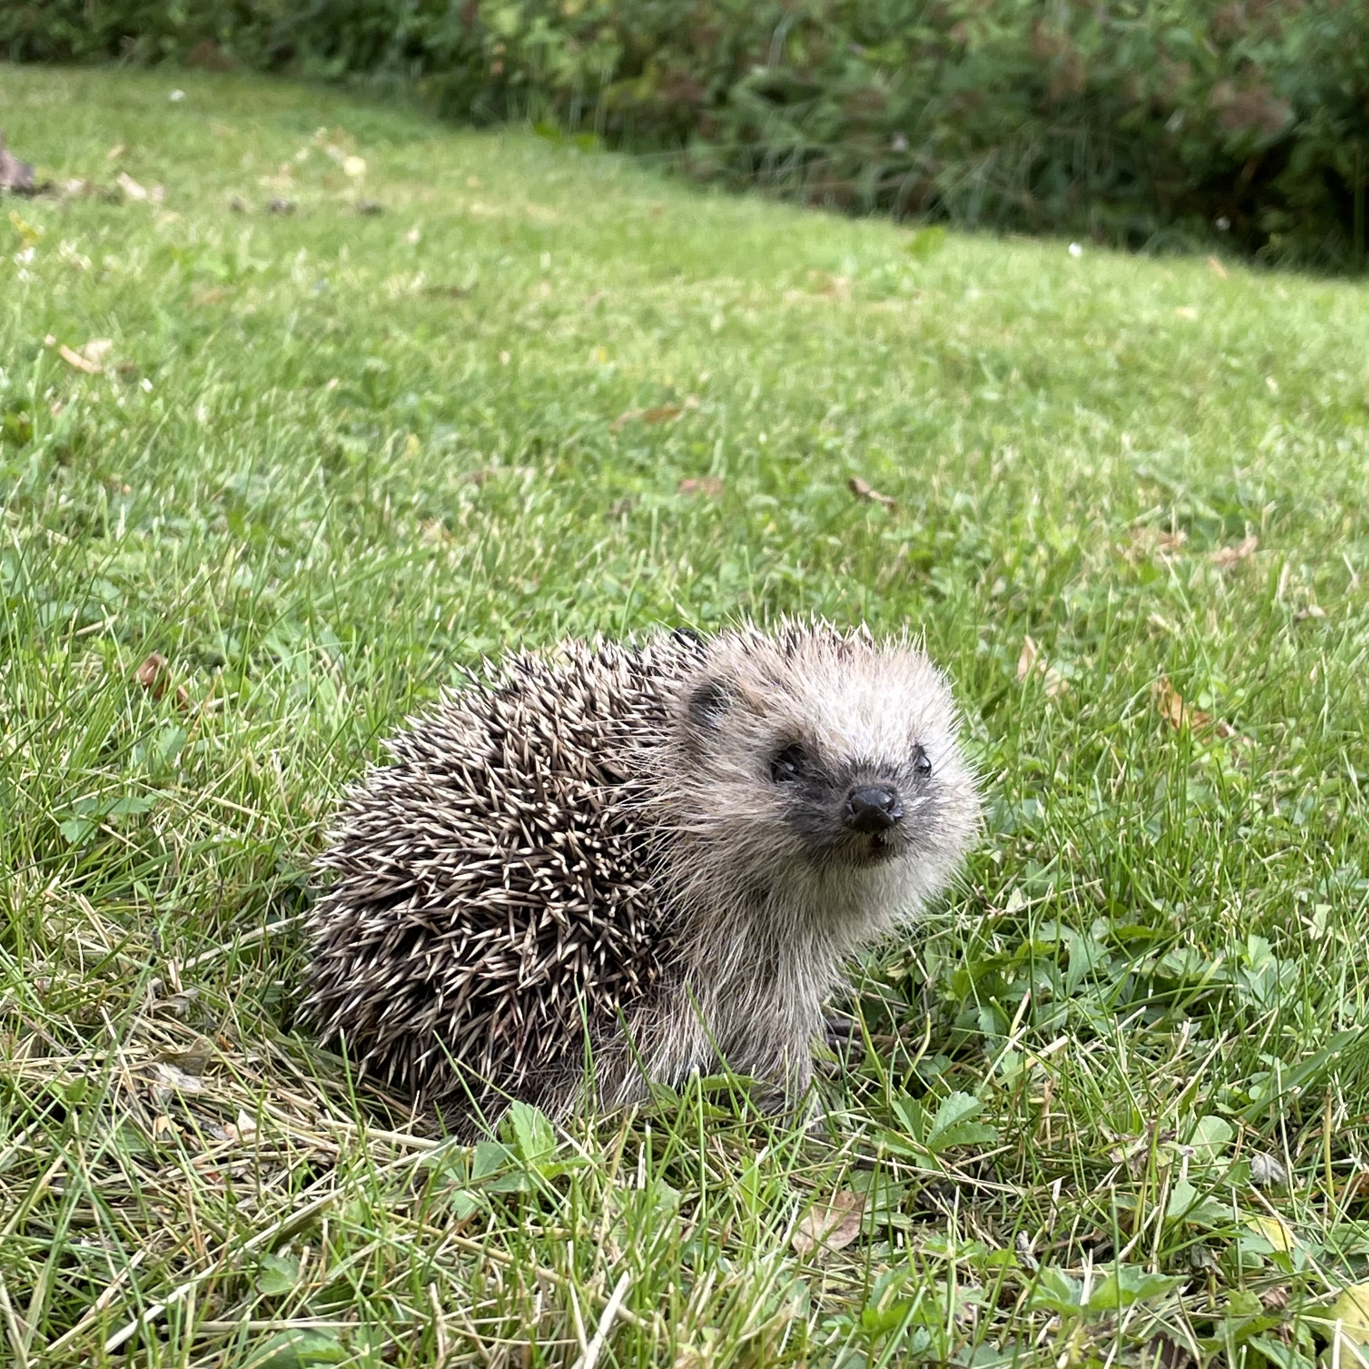
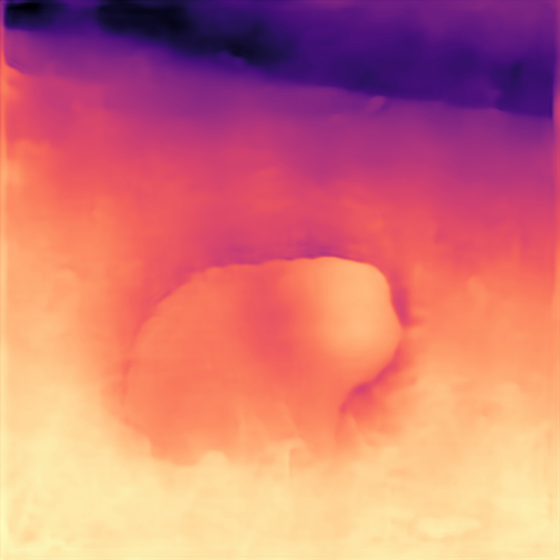

Dino and DinoV2
ViT:s from Meta AI
Trained on a wide range of images
Self-supervised training
Feature embedders
Segmentation and depth estimation
| Theory

Slide 8
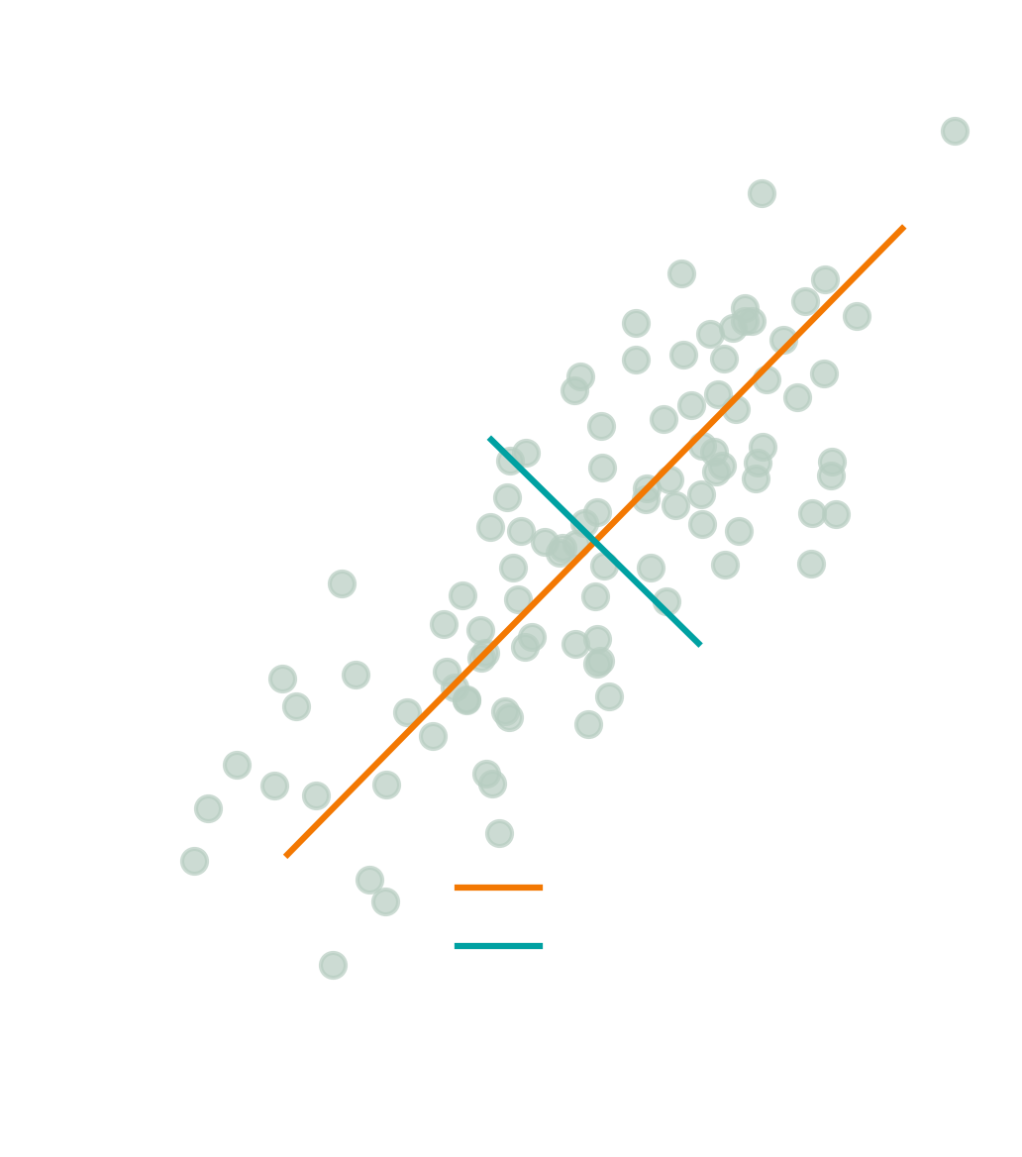
Dimensionality Reduction
Principal Component Analysis, PCA
High dimensional data to smaller dimensional data
SVD based PCA
Capture variation
Rank most important components
| Theory

Slide 9
Point Cloud Algorithm
Converting rgbd images to point clouds
Using camera intrinsics
Calculate the point cloud
| Theory

Slide 10
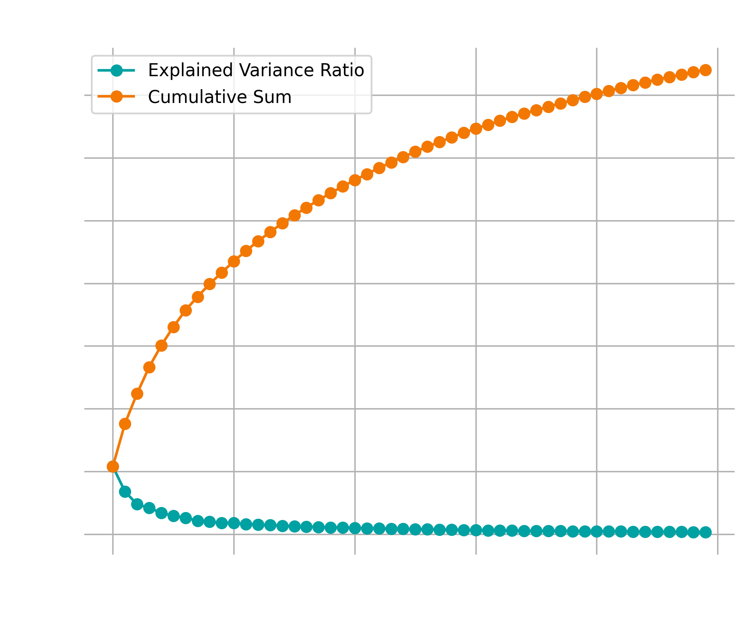
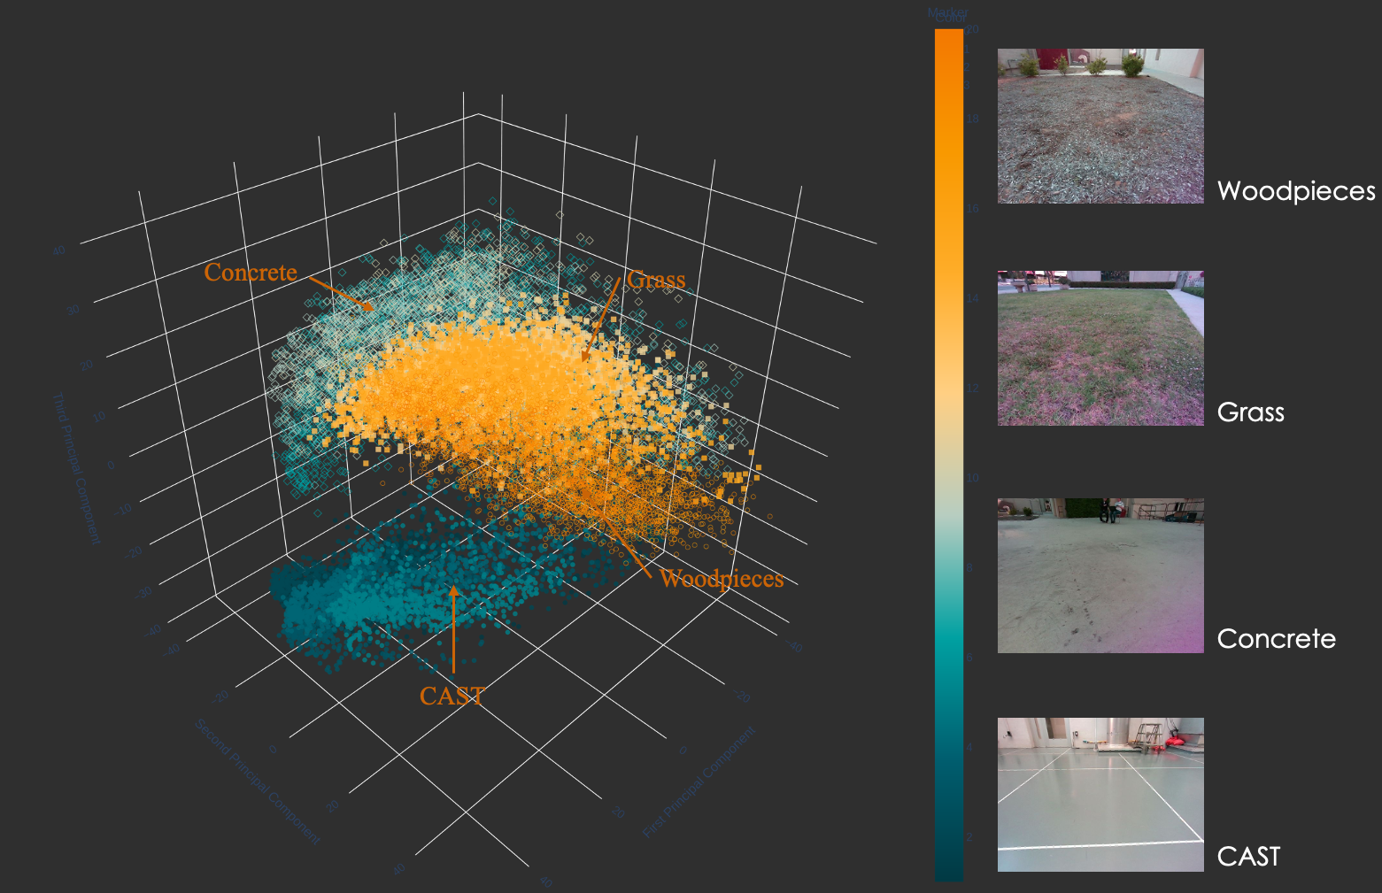
PCA on Different Terrains
Perform dimensionality reduction on images
Explained variance ratios
Visualize the 3 most important components
Recognizes features and clusters
| Results

Slide 11
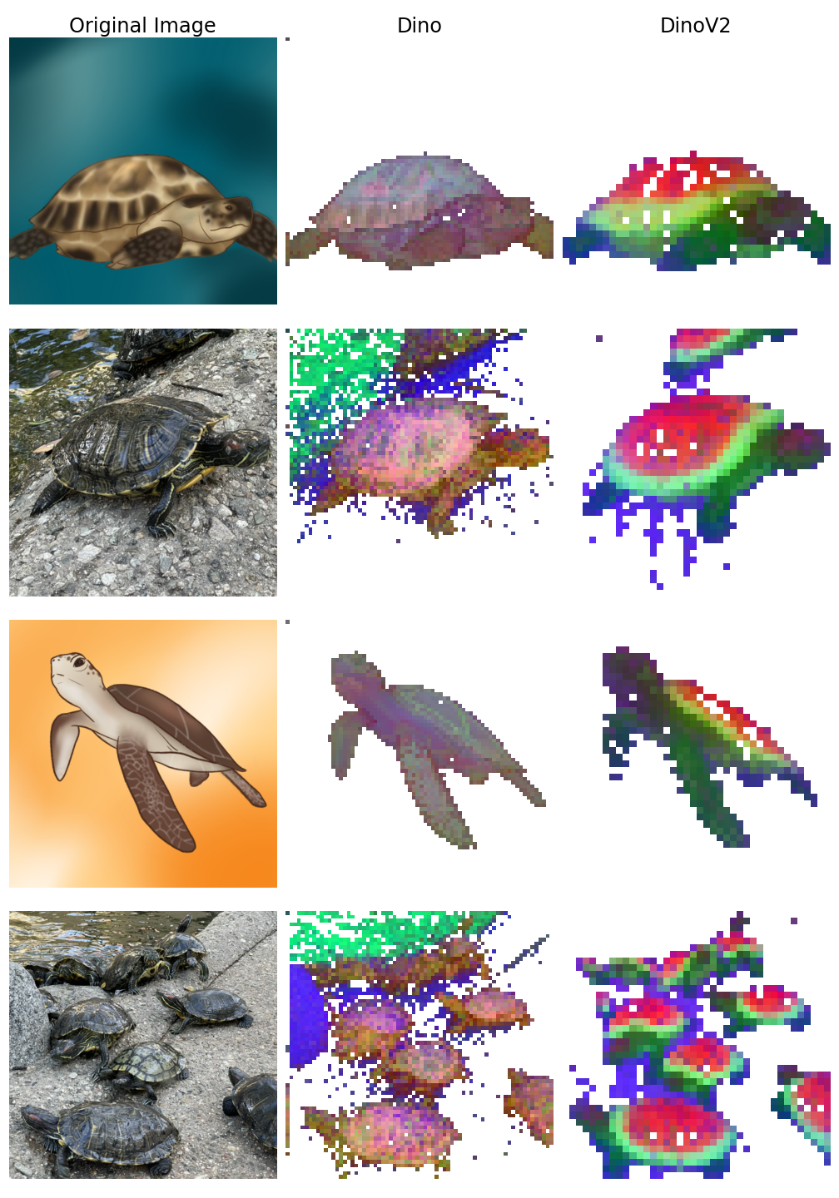
PCA on Dino and DinoV2
Dino
DinoV2
Dino
DinoV2
| Results

Slide 12
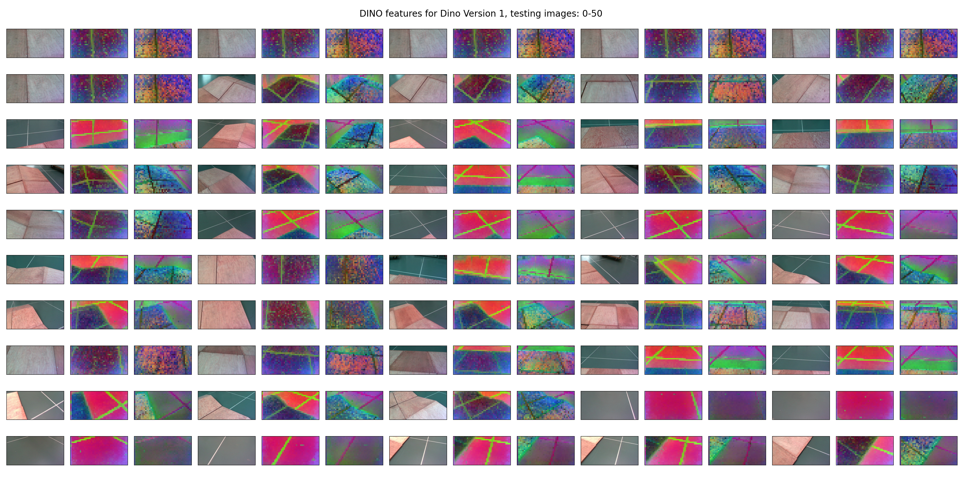
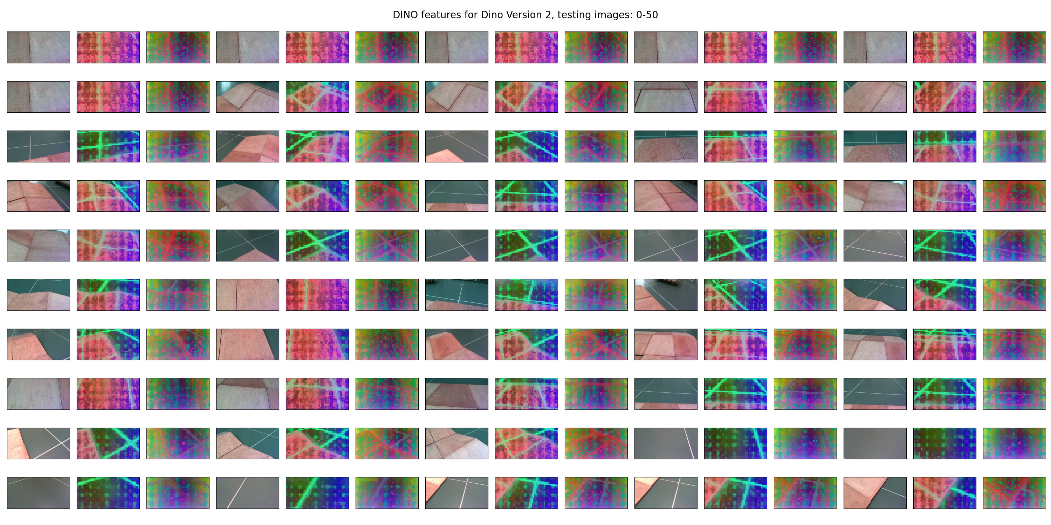
PCA on Dino and DinoV2
Dino
DinoV2
| Results

Slide 13
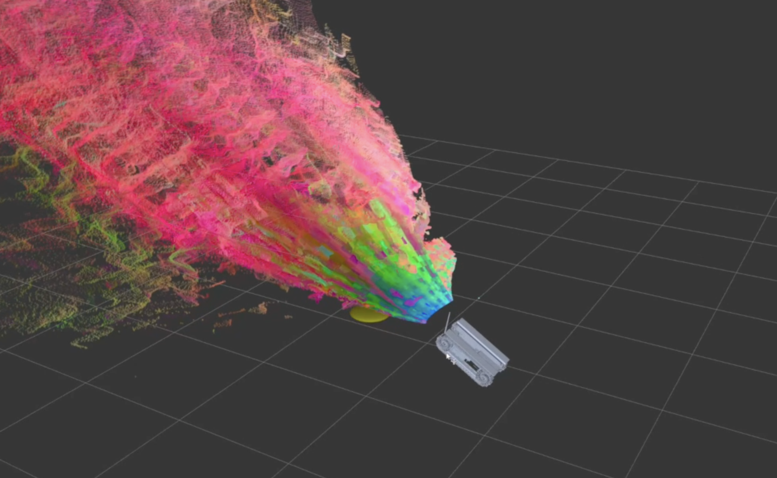
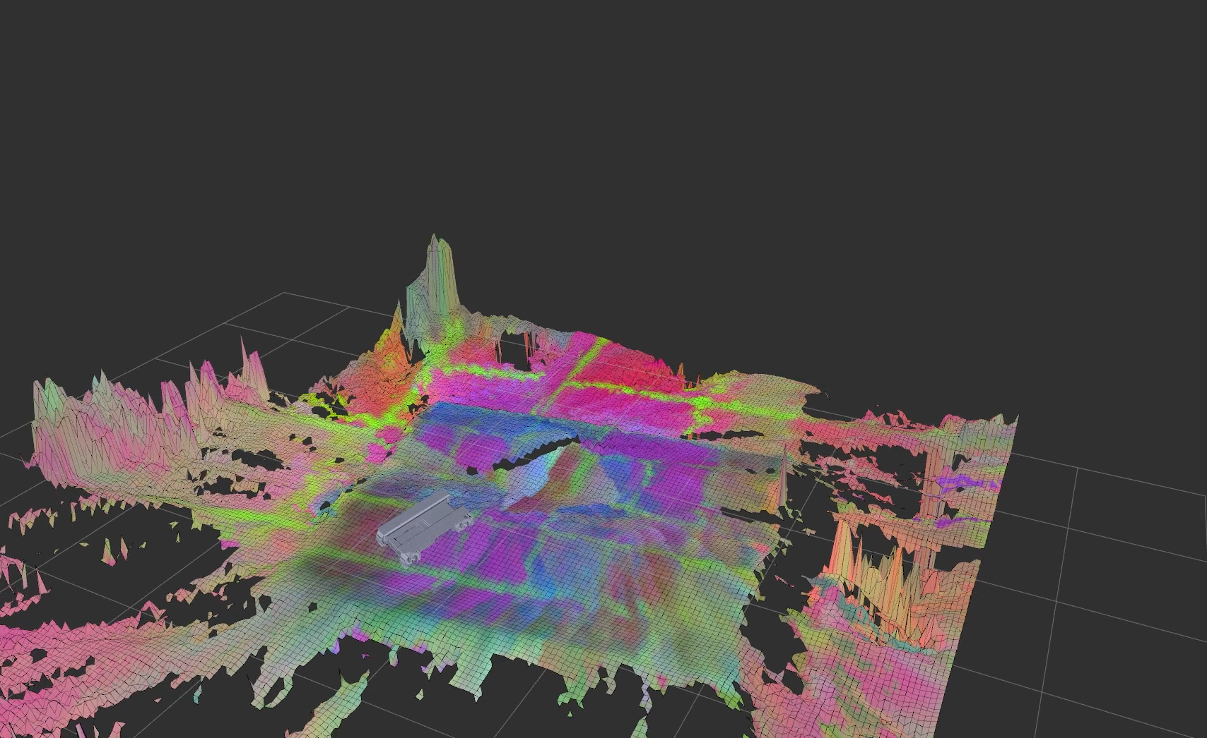

Features in Elevation Map
| Results

Slide 14
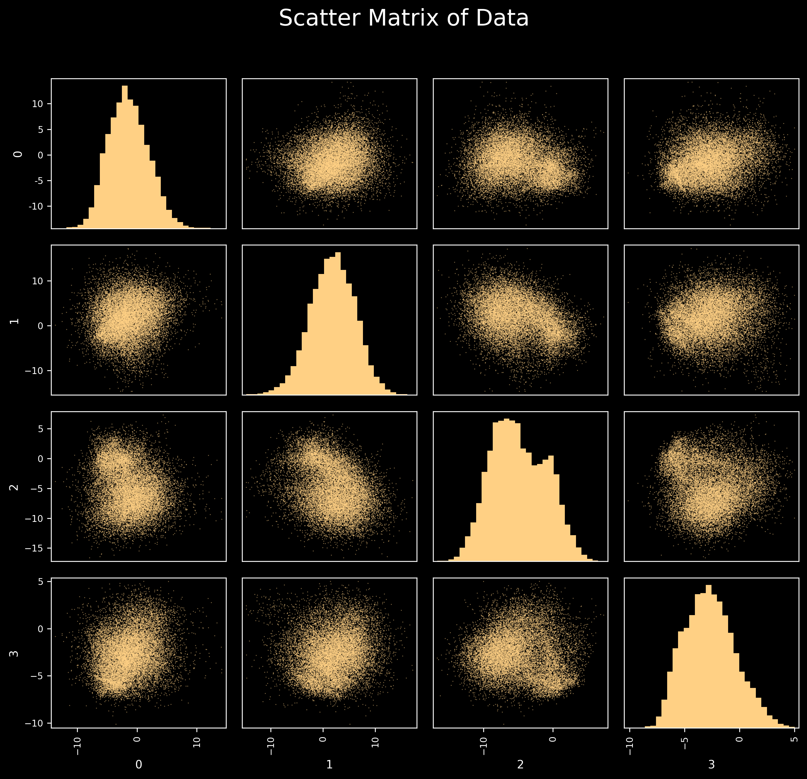
PCA to Reduce Dimensions
Low variance for every component
Spherical data?
Is it the best method?
Require a saved transform
| Discussion

Slide 15
Dino vs DinoV2
DinoV2 newer model with better performance
Performs better when doing PCA 2x
DinoV2 has some sort of grid pattern
Both seem to recognize different terrains
Dino
DinoV2
Dino
DinoV2
| Discussion

Slide 16
Elevation Map
| Discussion

Slide 17
Summary
1
2
3
4
Collect images
Extract RGBD images
Extract DINO features and project them as elevation map or point cloud
Adaptive Control
| Summary

Slide 18
Future Work
Evaluate PCA method
Try other methods, e.g. autoencoders?
Filter the elevation map
Evaluate the adaptive control in different terrains
| Summary

Slide 19
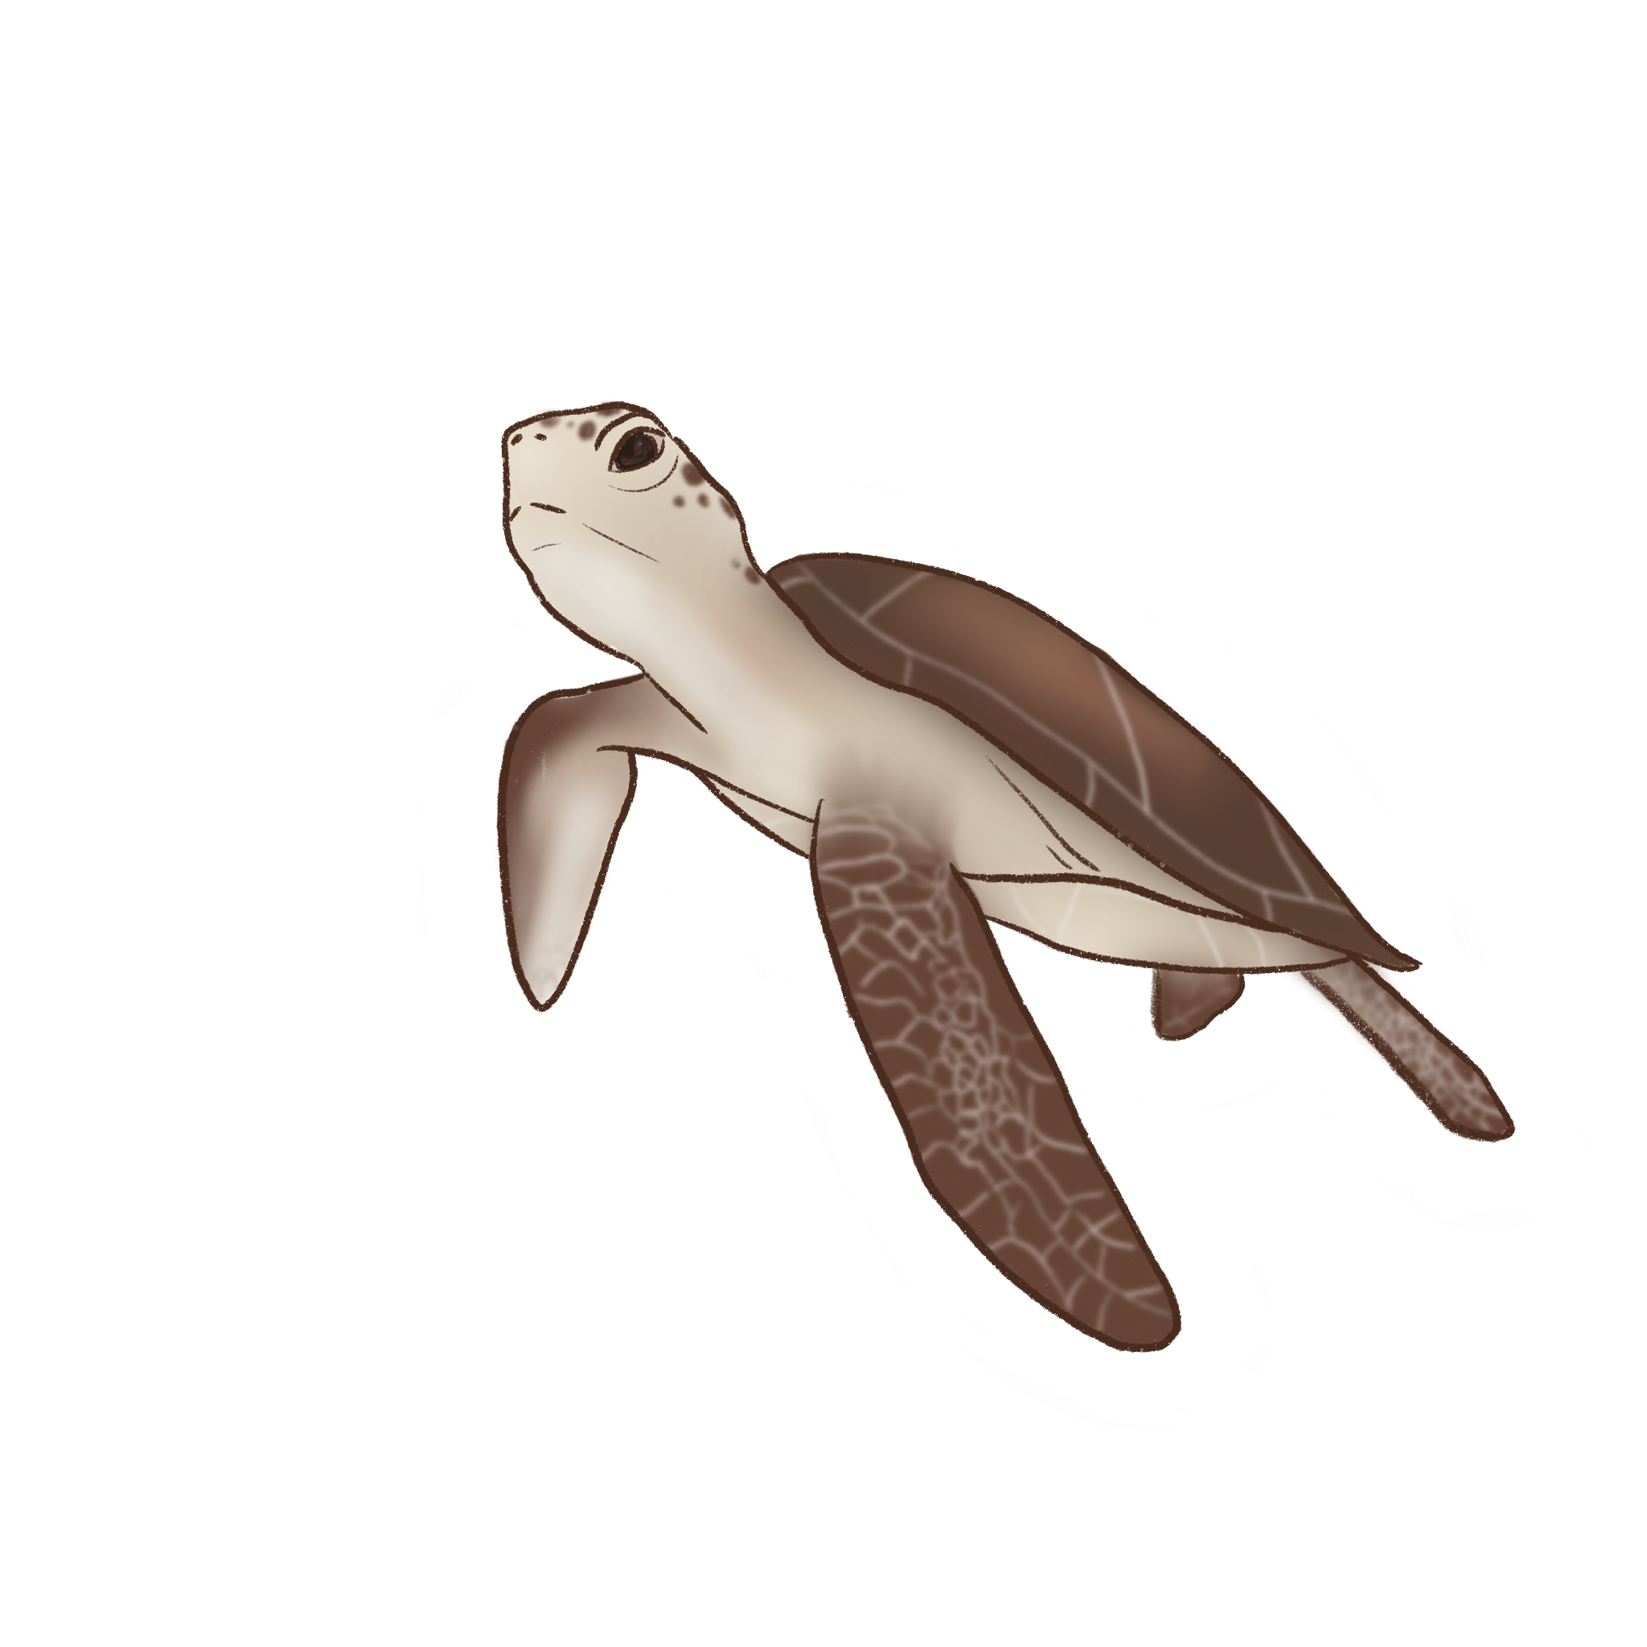
Acknowledgements
ARCLab and Professor Soon-Jo Chung for their warm welcome and support during the summer.
My older sister Jennelie for her wonderful turtle illustrations.
Mentor Sorina Lupu for her exceptional mentorship throughout the project.

Slide 20
Thank you for listening!
Emilia Sjögren
emsjog@kth.se
Mentors: Sorina Lupu, Soon-Jo Chung

Slide 21
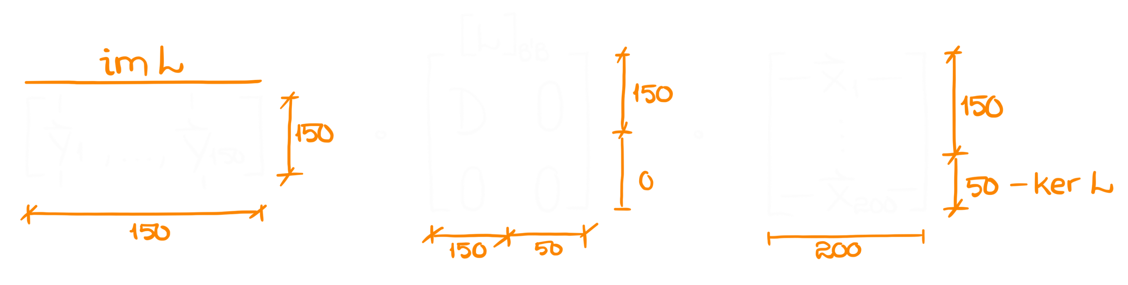
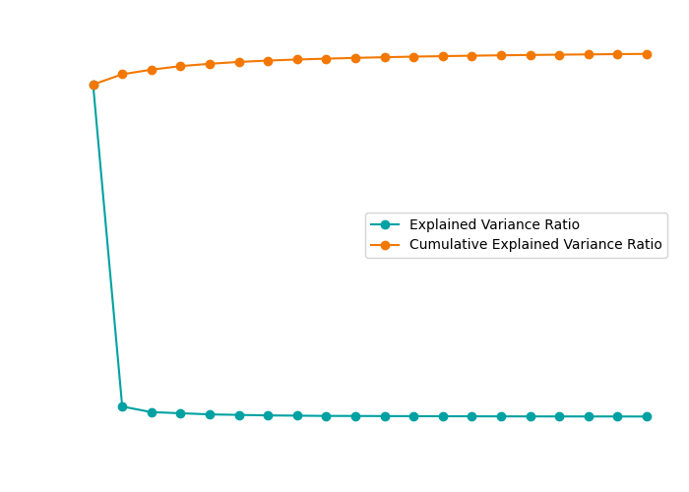
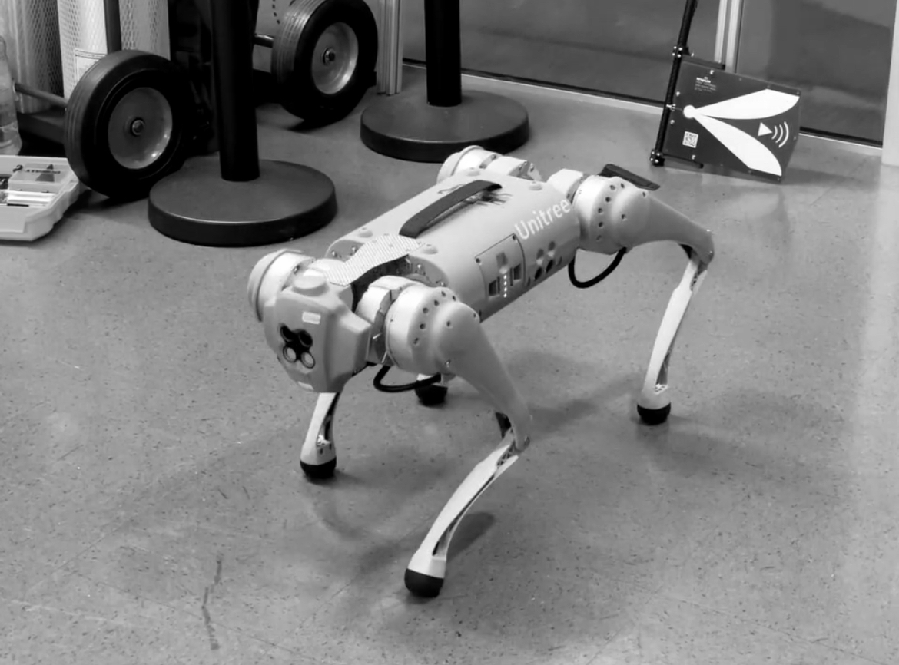
SVD based PCA
Singular Value Decomposition
A = USV^{H}
S - diagonal matrix with eigenvalues
U, V^{H} - eigenvectors
| Theory

Slide 22
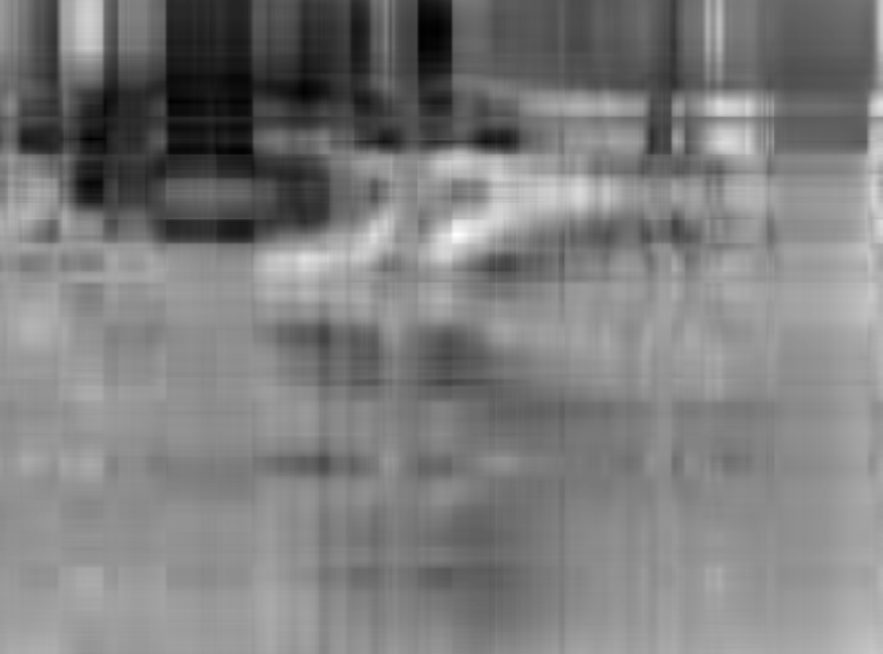
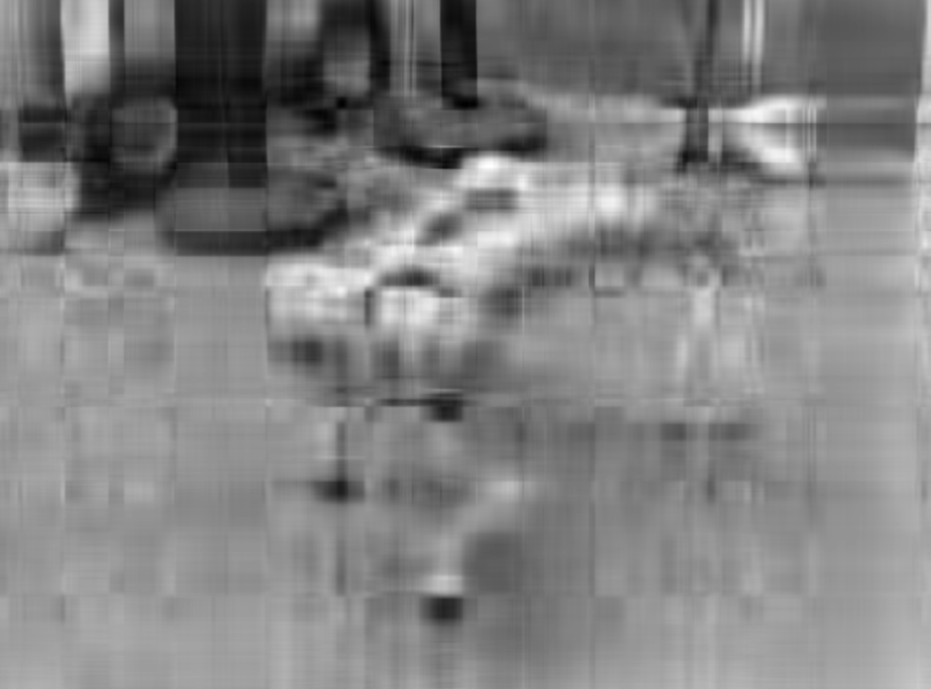



SVD based PCA
Original image
s = 5
s = 10
s = 50
s = 100
s = 20
| Theory

Slide 23
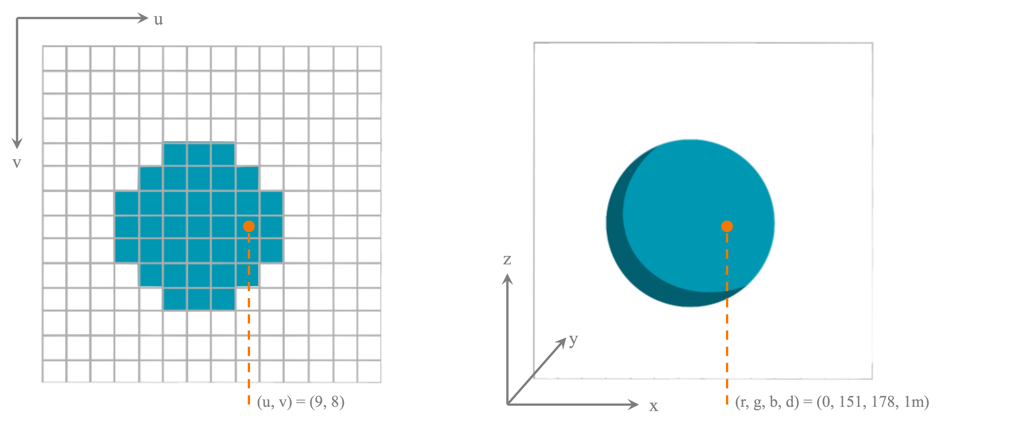
Point Cloud Algorithm
def uvd_to_xyz(u, v, d):
d *= self.pxToMetre
xx= (cx - u) / fx
yy= (cy - v) / fy
z = d / sqrt(1 + xx^2 + yy^2)
x = xx * z
y = yy * z
return x, y, z
Camera intrinsics
f_{x}, f_{y} – focal lengths
c_{x}, c_{y} – optical centers
| Theory

Slide 24



Autoencoders
| Theory

Slide 25
Autoencoders
| Theory

Slide 26
Autoencoders
| Theory

Slide 27
Autoencoders
| Theory

